Slide 1
CX707C R12 GNG Review
September.28.2023
Digital EE OPD&CI

Slide 2
Agenda
01
Software Overall Status and Summary
02
SW Change Scope
03
Open Issue Risk and Assessment
04
YF/TS/Ford Test Report
05
GNG Review Result

Slide 3
CX707_R12 GNG Summary
Cx707_R12 GNG Review
CX707_R12 GNG Summarize
SW Version |  | CX707_R12 | Milestone
Change Point
Next Step
Item | Material / Things |  | Status | Baidu | YFVE | TS
Supplier | Release Note |  | Green | Green
 | Test Report | Smoke | Green | Green
 |  | Funtion | Green | Green
 |  | MMOTA | Green | NA
 |  | EM Focus | Green | NA
 |  | Total | Green | Green
 | GNG Material | Report | Green | Green
 |  | Risk Analysis | Green | Green
3

Slide 4
Software Change Scope
02

Slide 5
SW Change Scope—Software Release Conlusion
CX707_R12 GNG Review
Software Release Conlusion
Baidu: 1、语音/账号/小程序/场景推荐/输入法/地图: 隐私合规需求合入, APIMCIM-23996 / APIMCIM-24062 2、安全管家/语音: 依据配置位区分云听入口; 来自福特FO需求,有邮件,没有jira单 3、语音: 删除小度小度唤醒词 APIMCIM-23998 4、语音: 个性化语音播报入口文字统一, APIMCIM-23997 5、小程序: MiniAPP-敏感信息授权期限更改, APIMCIM-24114 6、场景推荐:智能推荐增加敏感信息（位置）同意授权, APIMCIM-25586
5

Slide 6
Open Issue Risk and Assessment
03

Slide 7
Baidu Open Issue Risk Assessment --NA
Cx707_R12 GNG Review
7

Slide 8
YF/Baidu/TS/Ford Test Report
04

Slide 9
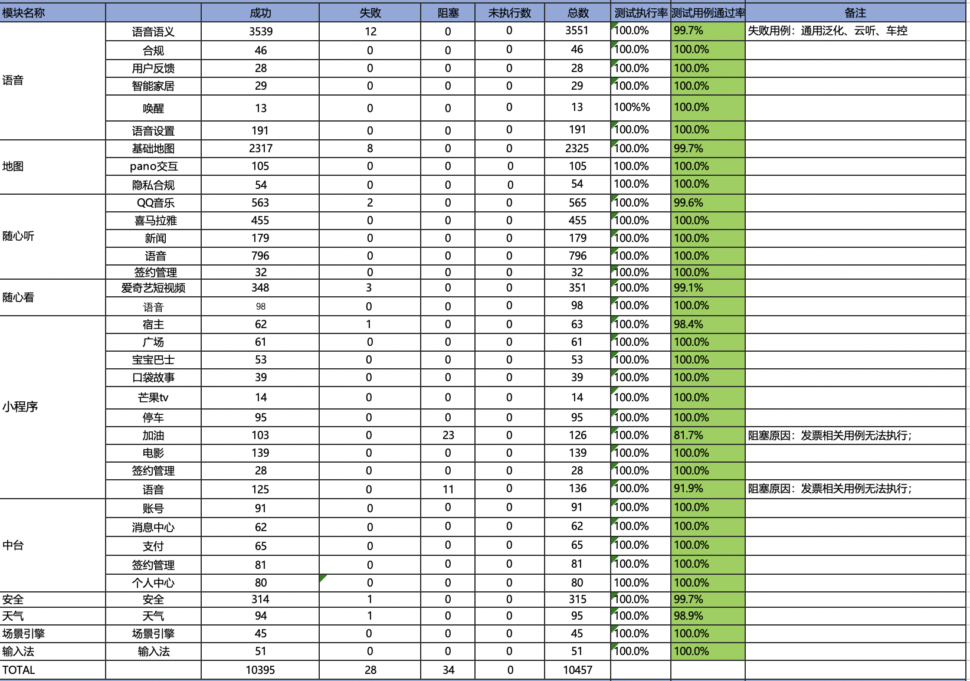

Baidu Smoke+ function Test Result Review- PASS
CX707_R12 GNG Review

